Slide 1
Quality assurance, 2022 Renata, Gintarė, Kristina, Vera

Slide 2
About us...
Name
I am working as...
Something more about me...

Slide 3
About you ☺ I am from… Interests…

Slide 4
Organizational „Stuff“
Plan for all days
Feedback in menti.com
Starting time (13:00), breaks
Where to reach us
Ask questions at any time ☺
Language

Slide 5

Activity & curiosity

Slide 6
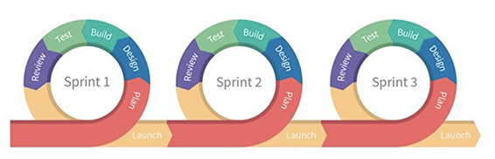
How this will be relevant to your 4 weeks project?

Slide 7

How to break things

Slide 8
Agenda
Tuesday (29th of March)
Introduction to Testing and Quality assurance (Renata)
Wednesday (30th of March)
Preparation for release (Kristina)
Testing trends (Gintarė)
Thursday (31st of March)
Introduction to automated testing (Vera)
API automated tests (Vera)
Friday (1st of April)
UI automated tests (Vera)
Questions/answers session
Preparation (Renata)
Stereotypes, Tester types, Tester vs. other roles (Gintarė)
About bugs (Kristina)

Slide 9
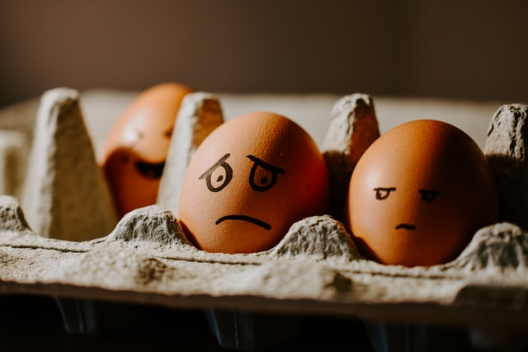
No practice of manual testing and finding bugs… ☹ or ☺

Slide 10

Let‘s begin...

